Slide 1
Computing Paradigms
An Overview of Modern Computing Models

Slide 2
What are the computing paradigms ?
Computing paradigms are different ways of processing data and using computer resources .
Cloud computing uses several computing paradigms to provide fast,reliable, and scalable services

Slide 3
There are 8 paradigms
1.distrubted computing
2.parllel computing
3.Grid computing
4.Cluster computing
5.Utility computing
6.cloud computing
7.Edge computing
8.Fog computing

Slide 4
Centralized Computing
Definition: All processing is done on a single central server or mainframe.
Example: Traditional mainframe systems.
Pros: Simple management, centralized control.
Cons: Scalability and fault tolerance issues.

Slide 5
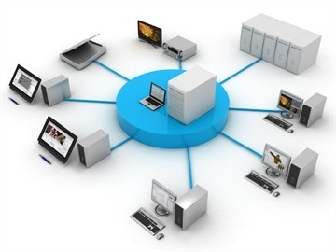

Slide 6
Distributed Computing
Multiple computers work together to solve a problem.
Resources are shared across different locations.
Improves performance and reliability.
Example: Large online banking systems.

Slide 7
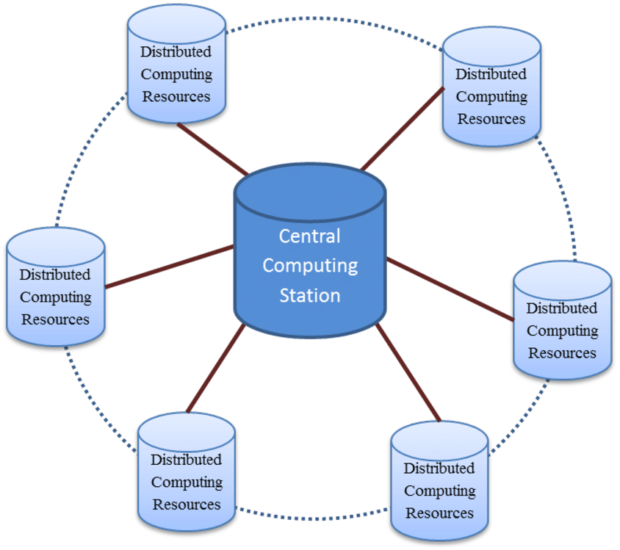
DISTIBUTED CLOUD COMPUTING

Slide 8
Parallel Computing
A large task is divided into smaller tasks.
Multiple processors work on these tasks at the same time.
Saves time and increases performance.
Example: Weather forecasting.

Slide 9
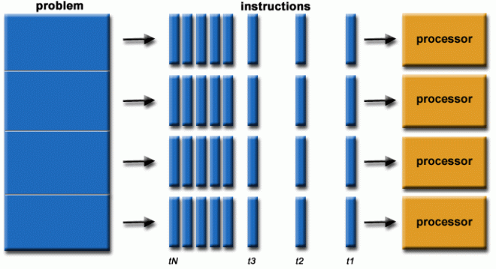
PARLLEL COMPUTING

Slide 10
Cluster Computing
A group of computers connected in one location works as a single system.
Provides high performance and backup if one computer fails.
Example: Web servers.

Slide 11
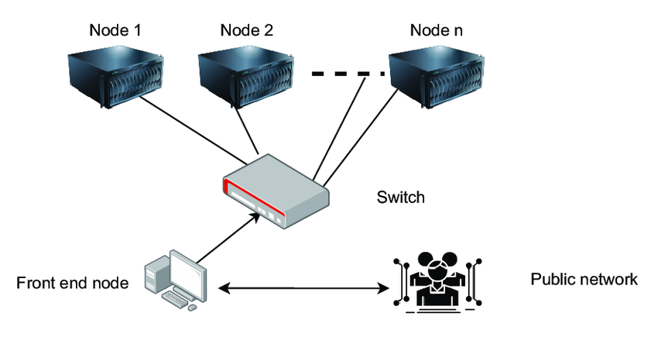
CLUSTER COMPUTING

Slide 12
Grid Computing
Computers from different locations or organizations work together.
Resources are shared to solve large problems.
Example: Scientific research.

Slide 13
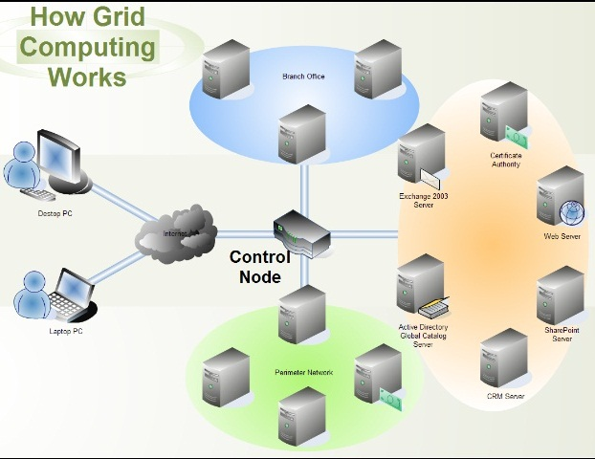
GRID COMPUTING

Slide 14
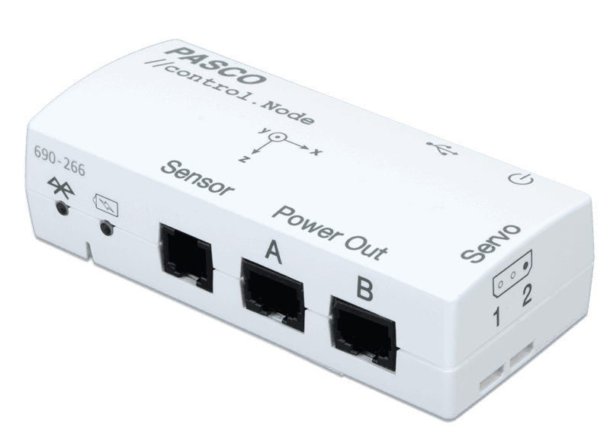
CONTROL NODE

Slide 15
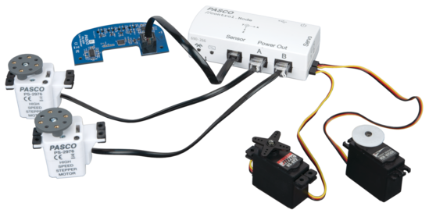
CONTROLLING THE COMPONENTS

Slide 16
Cloud Computing
Provides computing services over the internet.
Users can access servers, storage, software, and databases anytime.
Example: AWS, Azure, Google Cloud.
Service Models: IaaS, PaaS, SaaS

Slide 17
Edge Computing
Data is processed near the place where it is generated.
Reduces delay and improves speed.
Example: Smart cameras and IoT devices.
Example: Smart traffic lights, wearable devices.

Slide 18
Fog Computing
Processes data between edge devices and the cloud.
Reduces network traffic and improves efficiency.
Example: Industrial IoT systems.

Slide 19
Utility Computing
Users pay only for the computing resources they use.
Similar to paying for electricity or water
Helps reduce Costs.

Slide 20
Advantages of computing Paradigms
1. Faster data processing
2. Better performance
3. Easy resource sharing
4. High reliability
5. Cost-effective Easy to scale when demand increases

Slide 21
Memerable Definitions
Distributed Computing: Many computers work together.
Parallel Computing: Many processors work at the same time.
Grid Computing: Computers from different places share resources.

Slide 22
Memerable Defitions
Cluster Computing: Connected computers work as one system.
Utility Computing: Pay only for what you use.
Cloud Computing: Services are available over the internet.

Slide 23
Memerable Definition
Edge Computing: Data is processed near the source.
Fog Computing: Data is processed between edge devices and the cloud.

